Slide 1

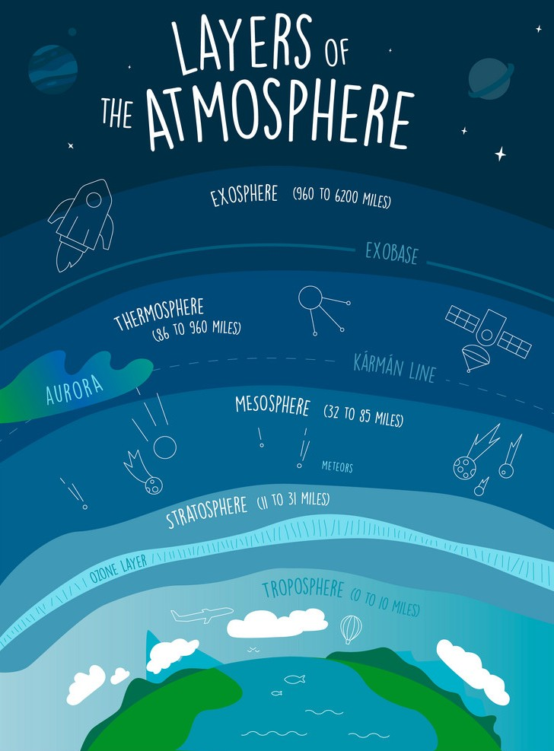
Layers of Atmosphere
: Demo Lecture
Presented by Shyawan Ghosh
Start

Slide 2
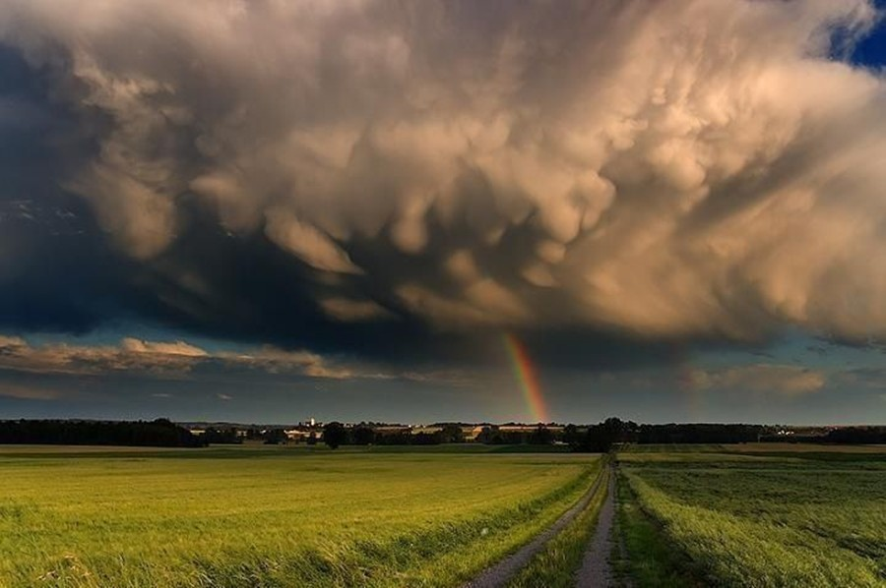
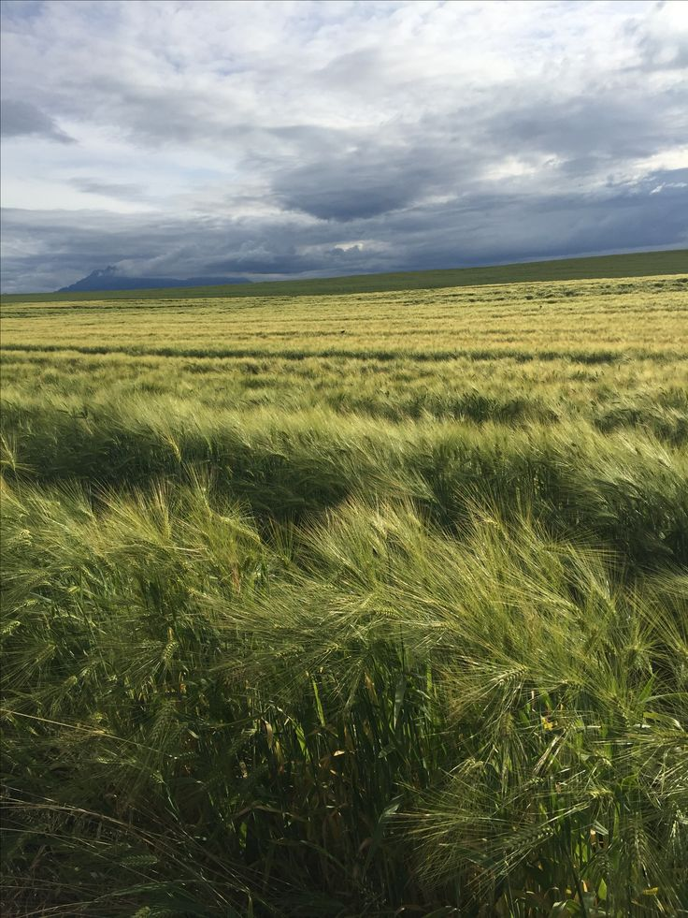
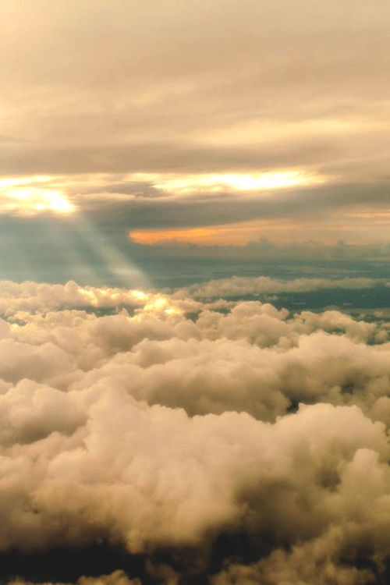
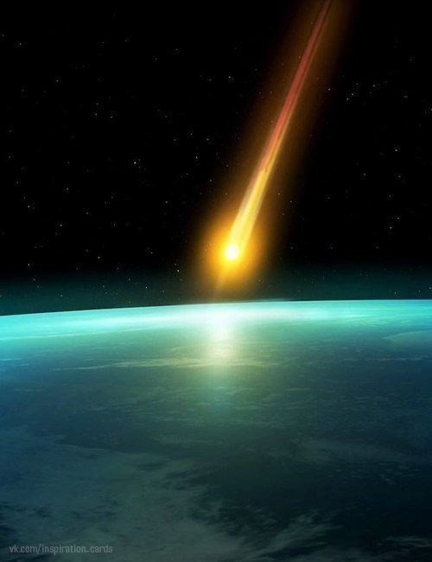
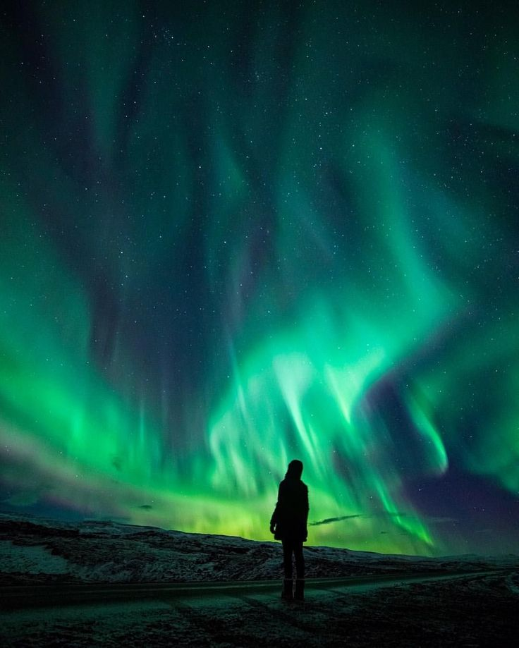
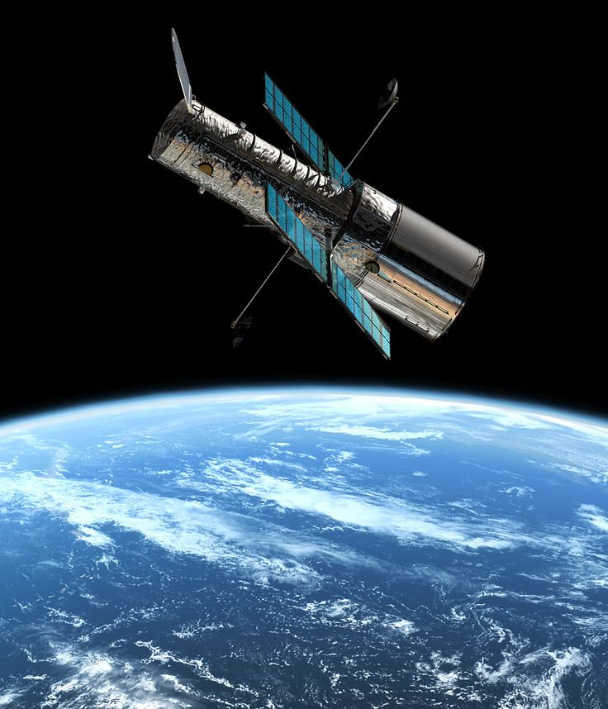
About Troposphere:
Height: Extends up to 8–15 km (5–9 miles) above Earth's surface.
Contains approximately 75% of the atmosphere's mass.
Weather events like rain, snow, storms, and clouds occur here.
Temperature decreases with altitude.
Specialty: Most life forms exist within this layer; it's the layer where breathable air is found.
Stratosphere
Mesosphere
Thermosphere
Exosphere
Layer 2
Layer 3
Layer 4
Layer 5
Layers
Troposphere
Layer 1

Slide 3
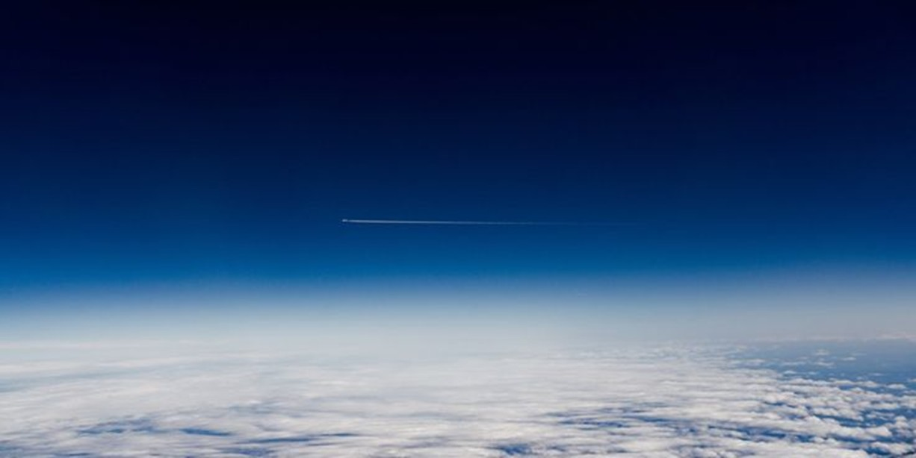
About Stratosphere
15 km to 50 km (9–31 miles).
Contains the ozone layer, which absorbs and protects Earth from harmful UV radiation.
Temperature increases with altitude due to ozone absorption of solar energy.
Free of weather disturbances, making it ideal for jet planes to fly.
Specialty: The ozone layer is crucial for shielding life on Earth from ultraviolet rays.
Mesosphere
Thermosphere
Exosphere
Troposphere
Layer 3
Layer 4
Layer 5
Layer 1
Layers
Stratosphere
Layer 2

Slide 4
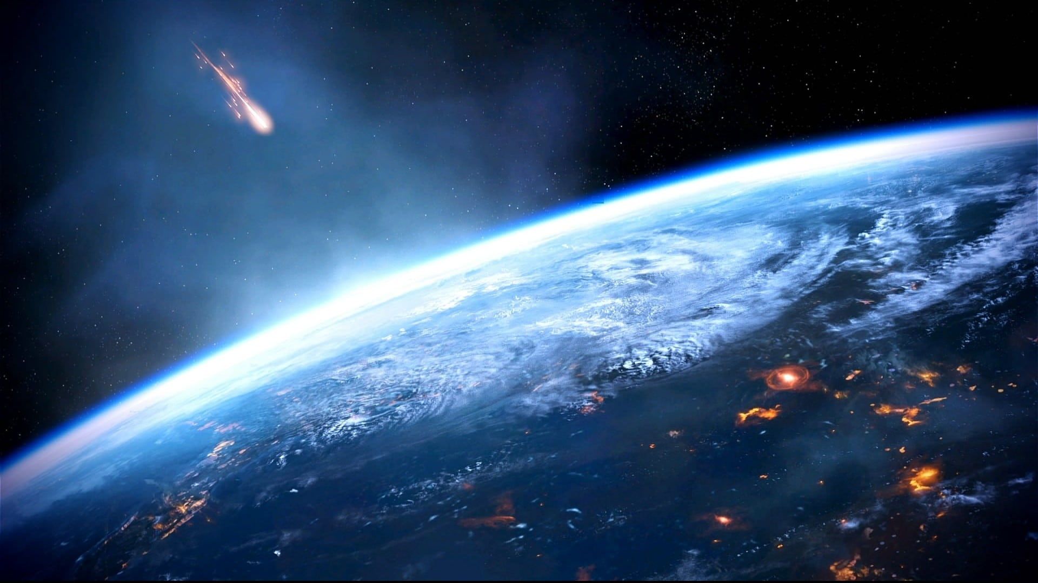
About Mesosphere
50 km to 85 km (31–53 miles).
Temperature decreases with altitude; coldest layer of the atmosphere.
Protects Earth from meteoroids by burning them up due to friction.
Thin air but still enough gas molecules to create significant resistance.
Specialty: Known as the "meteor-shield" layer.
Thermosphere
Exosphere
Troposphere
Stratosphere
Layer 4
Layer 5
Layer 1
Layer 2
Layers
Mesosphere
Layer 3

Slide 5
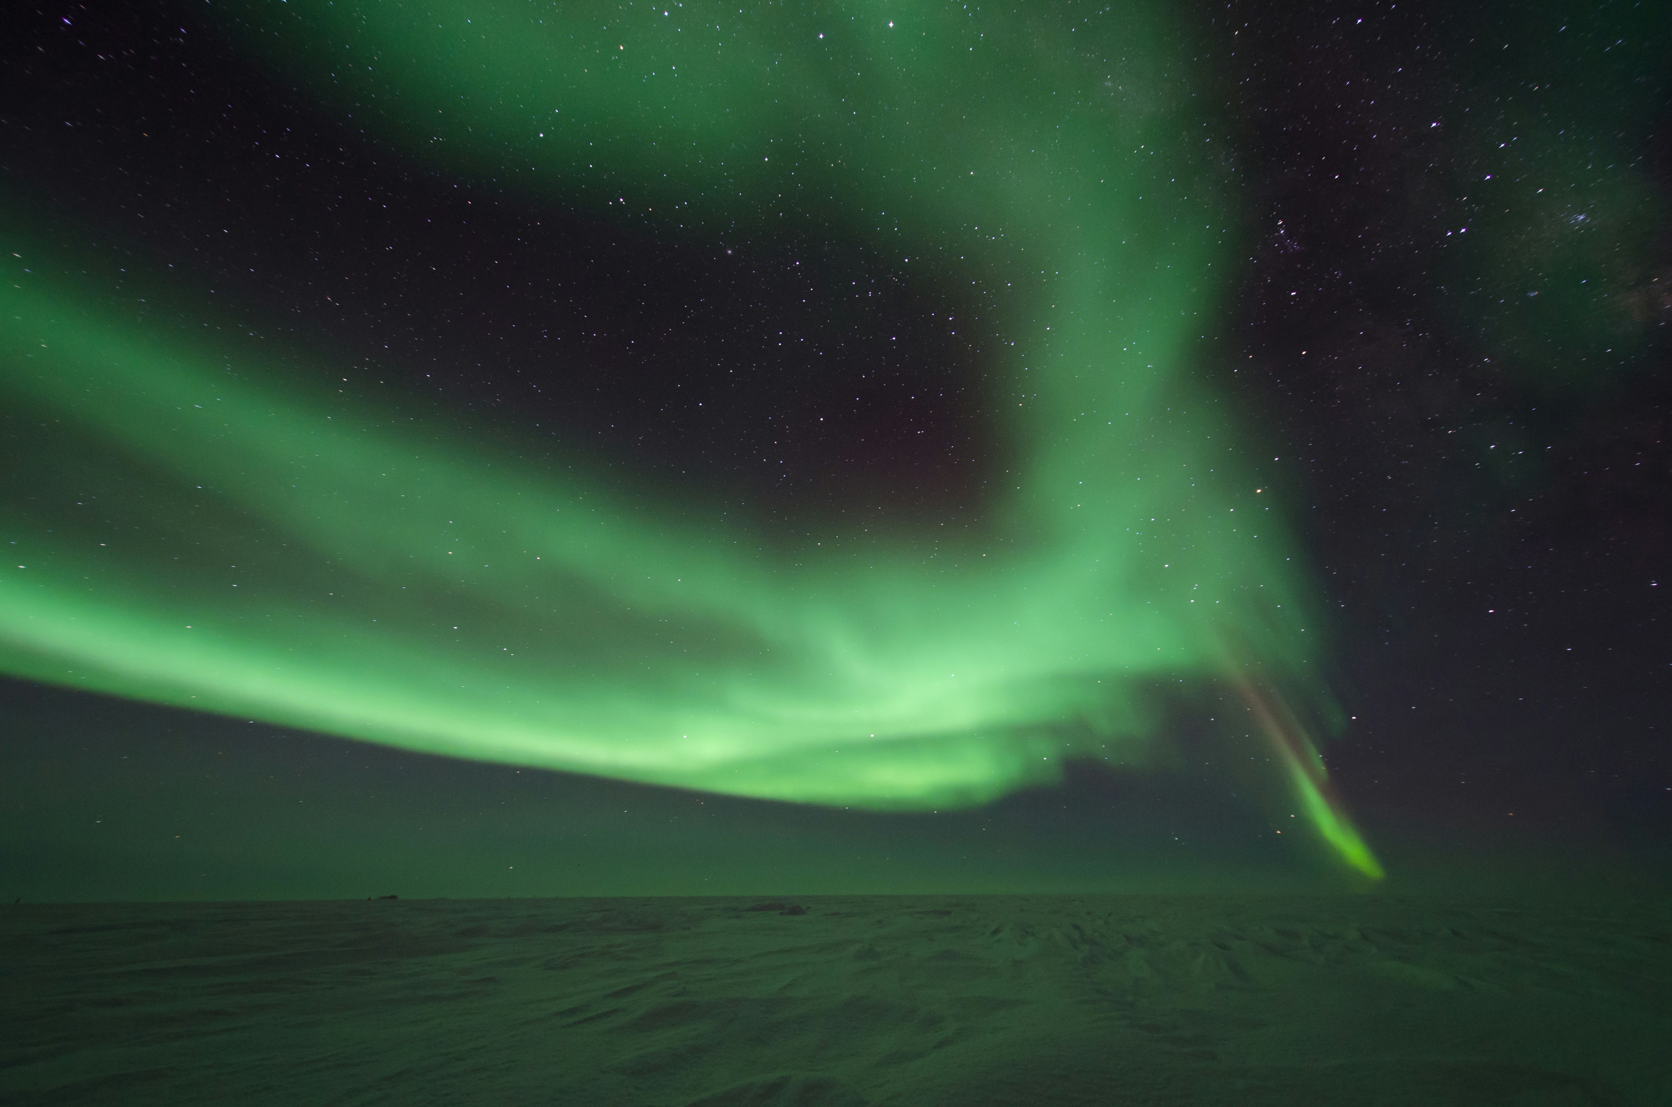
About Thermosphere
85 km to 600 km (53–373 miles).
Temperature increases dramatically with altitude, up to 2,500°C (4,500°F), but feels cold due to thin air.
Contains the ionosphere, which facilitates radio communication by reflecting radio waves.
Aurora phenomena (Northern and Southern Lights) occur here.
Specialty: Crucial for satellite operations and communication
Exosphere
Troposphere
Stratosphere
Mesosphere
Layer 5
Layer 1
Layer 2
Layer 3
Layers
Thermosphere
Layer 4

Slide 6
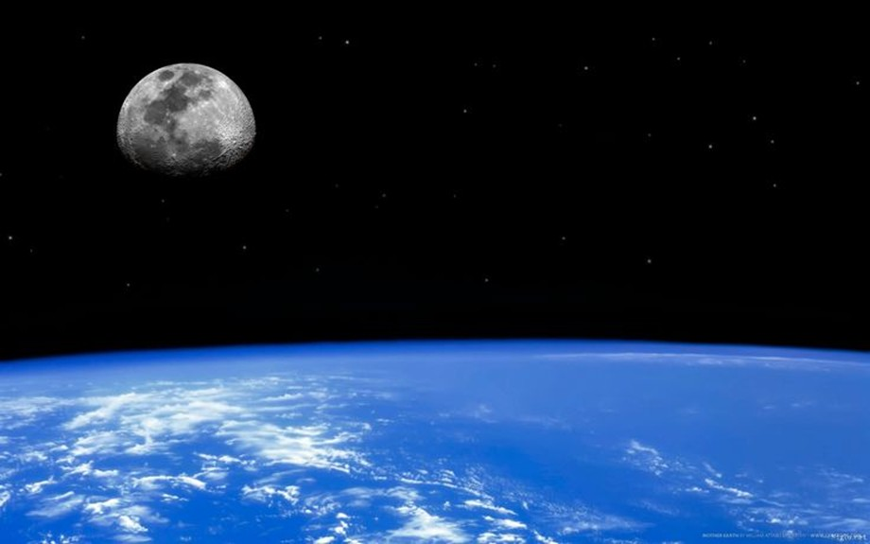
About Exosphere
600 km to 10,000 km (373–6,200 miles).
Outermost layer, transitioning into outer space.
Very sparse air, mostly hydrogen and helium.
Satellites orbit within this layer.
Specialty: Acts as the boundary between Earth's atmosphere and space.
Troposphere
Stratosphere
Canada
Japan
Layer 1
Layer 2
Layer 3
Layer 4
Layers
Exosphere
Layer 5

Slide 7
THANK YOU.
PPT Created by Manish Oraon
End

